Slide 1
Human Hybridomas

Slide 2
Disadvantages of murine Mabs
Murine Mabs application: Diagnostic tests in vitro
Their application in both therapeutics & in vivo diagnosis is hampered by the following adverse effects :
a. Risk of allergic reactions
b. Neutralization of any potentially beneficial effects produced in response to the foreign Ag.
These can be avoided by using human Mabs.

Slide 3
To overcome the adverse effects of murine Mabs in therapeutics, other Mabs are prepared using genetic engineering technology:
a. Chimaeric Mab: The constant region is replaced by human while the variable region remain of murine origin
Chimeric antibody names contain a -xi- stem. Examples of chimeric antibodies approved for human therapy include abciximab .
b. Humanized mab: In addition to the constant region of a Mab, the framework regions between the hypervariable CDRs are replaced by human
Humanized mab names contain a -zu- stem. Examples of humanized mab approved for human therapy include Pidilizumab
c. Human Mab:
Human Mab names contain a -u- stem.
Patritumab against breast cancer

Slide 4
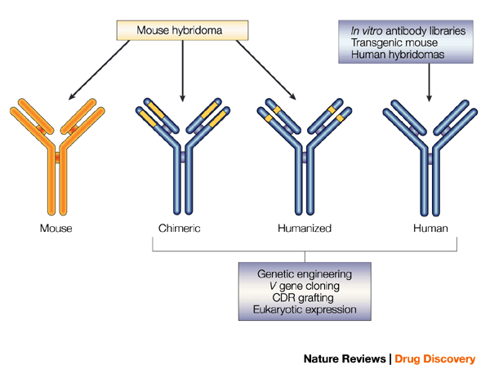

Slide 5
Humanized Mab
Chimeric human antibody mice Using Crisper 9 or zinc finger nuclease in gene editing
Humanized mAbs, of which only the CDRs of the light and heavy chains are murine, entered clinical development for the first time in 1988. CDR grafting is one of the most popular techniques in the production of humanized mAbs and was originally developed by Gregory P. Winter in 1986.
Using this technology, non-human CDR sequences are transplanted into human framework sequences, allowing the antibody to maintain the binding activity to the target antigen

Slide 6
Human Mab production still remains a difficult objective, the major problems are
1. Immunisation: is a major problem so that most of made human Mabs have been derived from naturally infected patients or from patients with active disease.
2. The source of immune lymphocytes:
The main problem : the use of lymphocytes from peripheral blood (accessible source).
Spleen or tonsils make better fusion partner than do from blood due to:
a. in blood, not enough Ag-specific B cells in a state of proliferation and differentiation
b. In blood, more suppressor cells and few APCs
3. The limitations of the immortal fusion partner:
a. human myelomas are difficult to establish in tissue culture :despite multiple attempts, no human myeloma line suitable for hybridoma production has been described.
b. have abundant RER, mitochondria and Golgi associated with high Ig production
c. are aneuploid
d. doubling time in culture is about 70 hrs

Slide 7
First method: Epstein-Barr virus transformation
EBV is human B lymphocytic herpes virus which is carried by about 90% of the adults.
EBV is a herpes virus which in vitro efficiently immortalizes nearly all human B lymphocytes. The lymphoblastoid diploid cell lines (LCL's) thus generated preserve the characteristics of the cells initially infected by the virus: the cells produce and secrete immunoglobulins and also express these molecules on their surface.
secretion of specific antibodies by cloned LCL's in limiting dilution cultures enables isolation of the desired cell lines.
The method allows the production of human IgM, IgG, IgA, and IgE monoclonal antibodies from any individual. Monoclonal antibodies produced by the EBV method resemble the antibody repertoire of the donor of the lymphocytes.

Slide 8
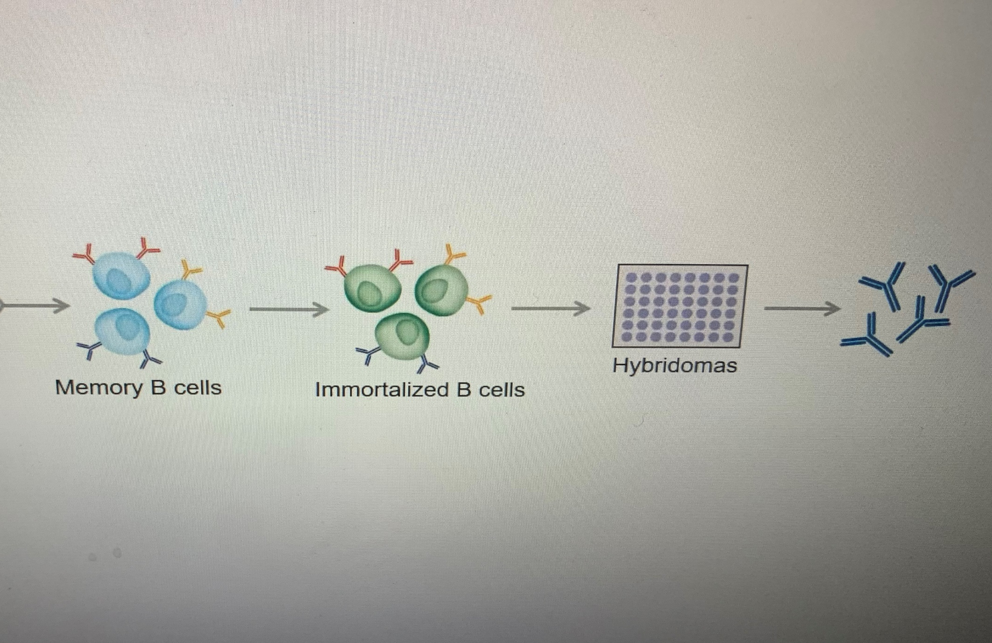
EBV

Slide 9
Blood
Peripheral Blood lymphocytes
Selection of Ag-specific B cells Infection with EBV with CpG
Infection with EBV with CpG Production of lymphoblastoid cell lines
Production of lymphoblastoid cell lines Selection of Ag-specific B cells
Cell cloning by limiting dilution Cell cloning by limiting dilution
Analysis of supernatant by ELISA

Slide 10
Peripheral blood
Isolation of lymphocytes Buffy coat (B and T cells)
Isolation of total B cells (specific and nonspecific)
Magnetic beads or nylon wool method
Isolation of specific B cells
Positive selection or negative selection method

Slide 11
1. Peripheral blood lymphocytes
buffy coat preparation using ficoll-hypaque (Has a density of 1.077 g/ml)
Anticoagulated blood is diluted and layered onto the ficoll in a centrifuge tube followed by Density gradient centrifugation
a. Lymphocytes, monocytes, and platelets remain at the interface (buffy coat).
b. Washing removes the platelets and residual ficoll
c. Mono can be removed by incubating the blood with iron carbon particles before separation.
d. At the bottom of the tube: RBCs and granulocytes

Slide 12
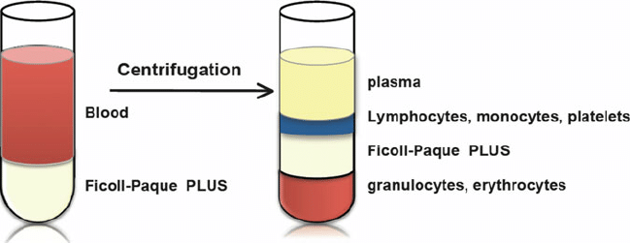
(Buffy coat)

Slide 13
2. Isolation of B cells:
a. In selection of B cells, magnetic beads coated with Abs against specific receptors like CD19, bind to the cell surface markers. This allows for the separation of unbound and desired cells.
b. Nylon wool method: using nylon wool as a solid phase matrix. This matric was coated with an acid-treated IgG fraction of polyclonal antibodies against human Ig, yielding purities higher than 95%.
The method can be used on a large scale for positive and negative cell selection, with very little non-specific binding. The isolated populations of B cells are fully functional.

Slide 16

3. Enrichment of specific B cells
Negative selection of specific B cells
Saturating the B cells with Ag, B cells will lose their surface Ig (capping).
sRBCs coated with F(ab)2 of anti human Ig: only nonspecific B cells bind to SRBCs
b. Positive selection
B cells with surface Ig incubated with sRBCs coated with the specific Ag

Slide 19
Second method: Phage display method
1. Isolation of B-lymphocytes from the human blood
2. conversion of the mRNA into cDNA .
3. Amplification of specific variable region: PCR is used in order to amplify the variable regions of both heavy and light chain and the expressed segments of the variable region are cloned. Defined sets of primers specific for the different VH and VL chain–region gene families then allow amplification of all transcribed rearranged variable regions within a given immunoglobulin repertoire for library construction, thus reflecting all antibody specificities in a particular individual
4. Cloning into vector: The antibody genes are inserted into phage directly.
The bacteriophage is used in order to infect the E.coli . E. coli is used as a vector it starts to produce bacteriophage variable regions of heavy and light chain. Then the variable regions of specific antigen are used for reinoculation of E.coli containing bacteriophage.
5. Library of phage displayed antibody The isolation of cells containing plasmid is done followed by sequencing and the library of the specific phage displayed antibodies is produced as the result.

Slide 20
Performing a Phage Display Selection Experiment
Phage display selection is a high throughput method used to discover antibodies specific to different antigens. The protocol includes rounds of five steps (Figure).
1. The first step is addition of a phage library, where the library is added to a well or vial in which the antigen is presented (Figure A). Antigen presentation can be achieved via direct coating (adsorption) or via a capture system (such as streptavidin-biotin).
2. The second step involves binding, where the phages displaying the highest affinity antibodies bind the epitopes of the antigen (Figure B),
3. after which the vial is washed to remove non-binding phages (Figure C).
4. After washing, the bound phages are eluted by enzymatic digestion using trypsin or by other means of elution (e.g., dilute acid or base) (Figure D). When enzymatic digestion is employed, this step renders bald phages non-infective, thereby improving the selection of antibody-displaying phages that are still infective.
5. In the fifth step, helper phages are added to allow for amplification of the eluted infective phages in E. coli (Figure E). To accumulate phages displaying high affinity antibody fragments, these five steps are usually repeated 1-3 times with the amplified phages from the preceding round of panning. Titration of phage output numbers may also be utilized to monitor progress, and polyclonal phage ELISA used to confirm selection of a population of binders.

Slide 21
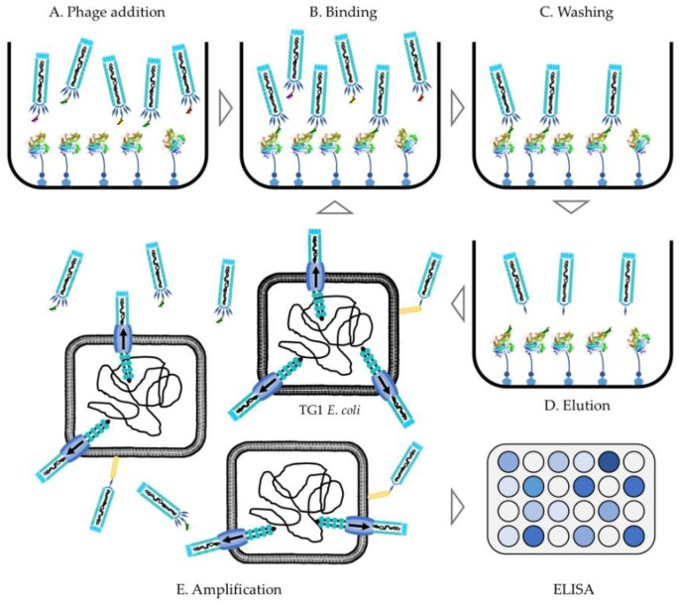
The five steps in a phage display selection experiment. Addition of phage library (A) refers to the addition of phages to an antigen-coated vial. The phages displaying the highest affinity scFvs will bind (B) the antigen, while unspecific binders will be removed during the washing step (C).After washing, the antigen-specific phages can be eluted (D) using trypsin digestion (or other means of elution) Then, phages are amplified (E) in E. coli and a new panning round can be initiated to further accumulate phages displaying high affinity antibody fragments. Binding can be evaluated using both ELISA and plate tests.

Slide 22
To date, there are at least 25 therapeutic antibodies that are derived from phage display libraries approved for clinical use or in various stages of clinical trials. Adalimumab is an example of a Mab approved for human therapy that was created through phage display
A. One advantage of phage display is that fully human antibody can be isolated.
B. Furthermore, phage display offers greater control over the selection process than using animal immunization.
C. Finally, phage display is more readily accessible as it does not require expensive equipment like fluorescence-activated cell sorter (FACS).

Slide 23
Viral inactivation
Solvent/detergent inactivation
The detergent typically used is Triton X-100.
Pasteurization (heating)
Typical incubation lasts for 10 hours and is performed at 60°C
Acidic pH inactivation
Incubation for this process typically occurs at a pH of 4 and lasts anywhere between 6 hours.
Ultraviolet (UV) inactivation[edit]
UV rays can damage the DNA of living organisms by creating nucleic acid dimers.

Slide 24
Third method: Transgenic Mabs
Transgenic animals represent another technology for obtaining fully human mAbs . This technology was introduced in 1994 by the publication of the transgenic mouse line the HuMabMouse. The lines were genetically modified such that human Ig genes were inserted into the genome, replacing the endogenous Ig genes and making these animals capable of synthesizing fully human antibodies upon immunization
The first human antibody generated in a transgenic mouse to anti-epidermal growth factor receptor (EGFR), panitumumab, was approved by the US FDA in 2006.
. Depending on the immunization protocol, high-affinity human antibodies can be obtained through further selection of hybridoma clones generated from immunized transgenic mice.

Slide 25
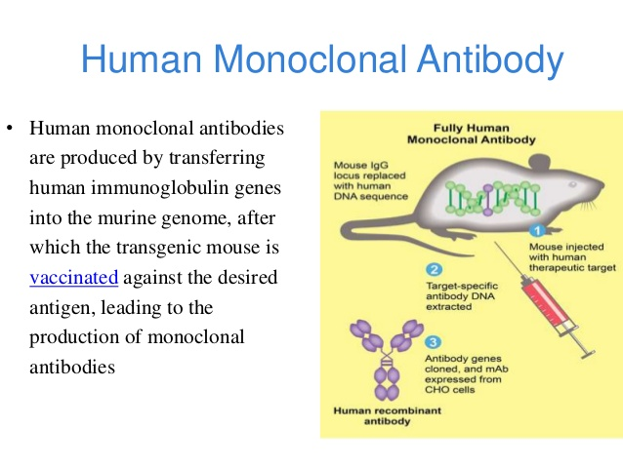

Slide 26
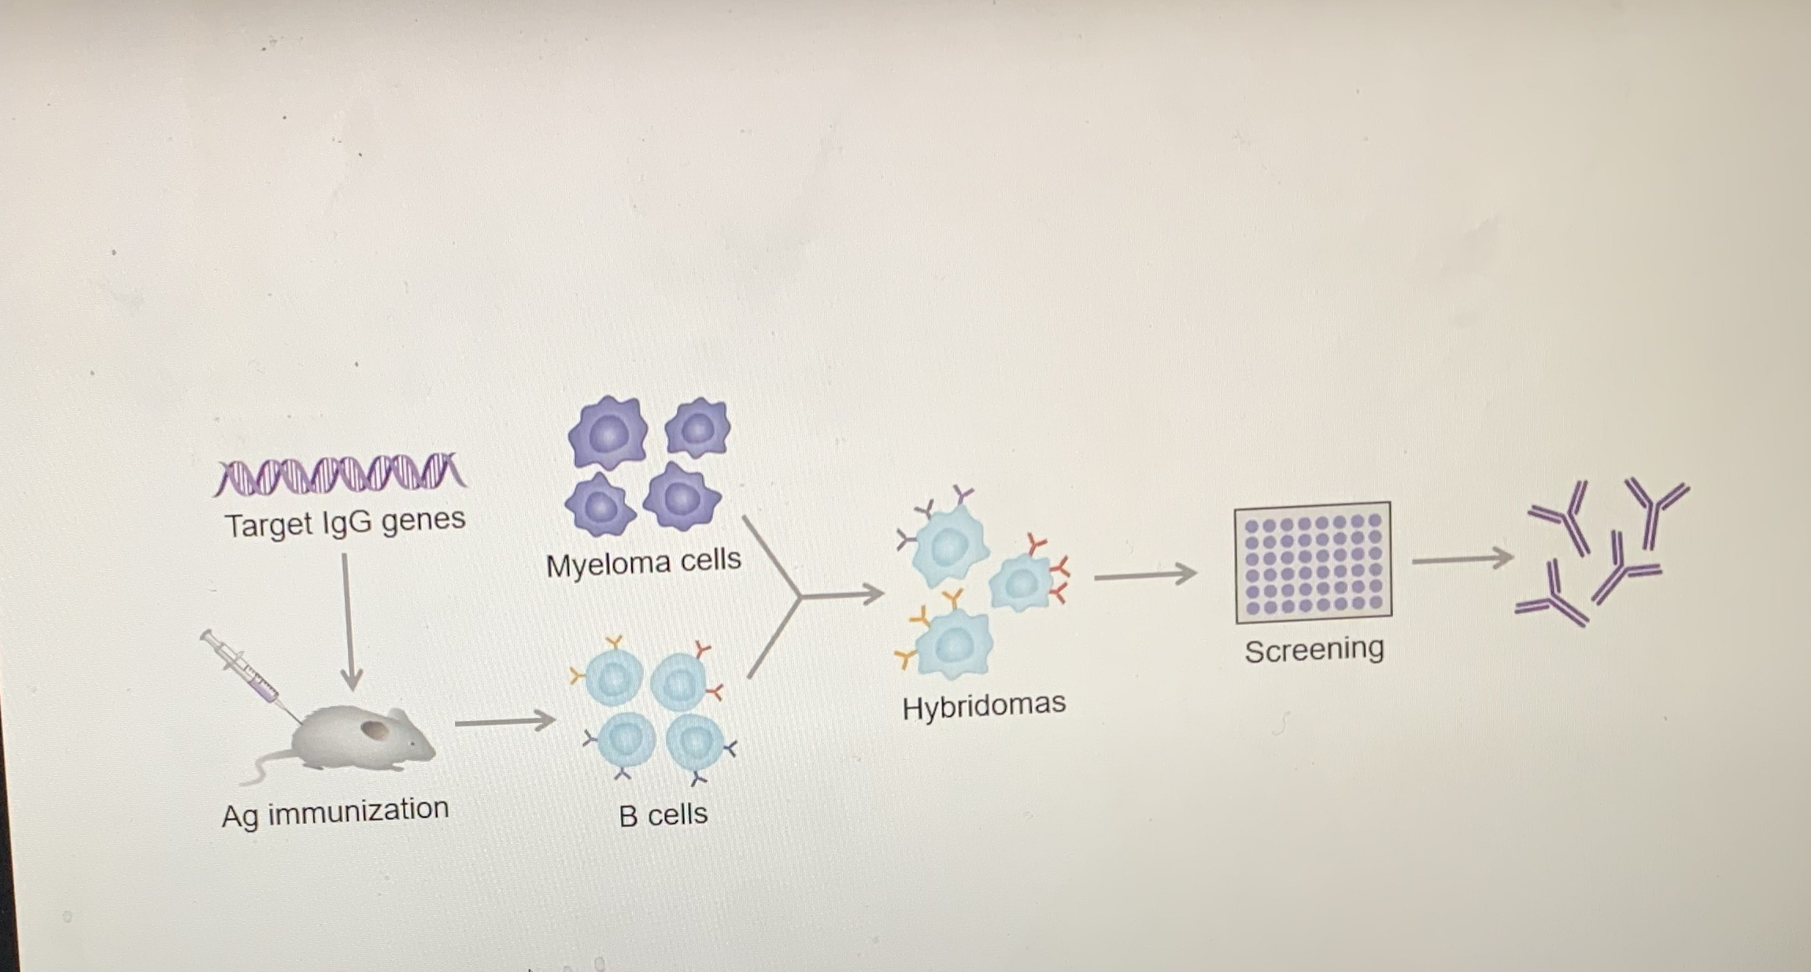

Slide 27
Phage display method
Methods of human Mab production
https://www.youtube.com/watch?v=O5_abD0eiIE
Phage display method
https://www.youtube.com/watch?v=VgDF-N-73U0
https://www.youtube.com/watch?v=ybda36T-NXo

Slide 28
Common Strategies for Virus Clearance in mAb Purification
Achieving zero risk of viral contamination in biologic production is impossible. But a strategy to ensure safety of biopharmaceuticals through risk mitigation involves careful choice and extensive testing of source materials; confirmed absence of contaminating infectious viruses in intermediates at relevant steps in a production process; and assessment of how well a manufacturing process inactivates and removes viruses. Quantitative polymerase chain reaction (qPCR) can be used to assess virus removal.

Slide 29
Affinity Chromatography
MAb capture is widely performed by Protein A affinity chromatography. Besides the efficient removal of process-related impurities like host cell proteins and DNA, Protein A can be used for virus removal. Most viruses flow through the column.
As Protein A is eluted at acidic pH, a chemical inactivation of enveloped viruses by denaturation of the envelope proteins is typically performed. Generally this inactivation step is performed at pH 3.0-4.0.3.
As mAbs are typically basic proteins, at pH 6-8 viruses are retained by the electropositive ligand whereas most mAbs pass the column.
Protein A/G chrom. were very effective for eliminating both enveloped and non-enveloped viruses

Slide 30
pH Treatment
Direct exposure of process intermediate to pH extremes has been used for viral clearance in biopharmaceutical manufacturing.
studies have proven that low pH treatment (e.g., pH 3.0–3.6) of MAbs following affinity chromatography is effective against enveloped viruses.
High pH treatment using a sodium hydroxide solution is used to sanitize many chromatography columns, which can be effective against both enveloped and nonenveloped viruses.

Slide 31
Solvent/Detergent
Treatment of plasma-derived products with 0.3% tri(n-butyl) phosphate (TNBP)/0.2% sodium cholate (CA) can provide effective inactivation of infectious viruses. A detergent solubilizes a viral envelope’s lipid membrane structure. That disruption prevents a virus from binding to or infecting cells, thus rendering it inactive. It is important to note that this process does not inactivate nonenveloped viruses.
But because S/D targets lipids and lipid derivatives, this technique generally does not affect the potency of recombinant protein products .
A solvent/detergent step based on 1% triton X-100 rapidly inactivating a range of enveloped viruses by >6 log inactivation within 1 min of a 60 min treatment time.
Caprylic acid (CA) is described as a standard precipitation method for the isolation of immunoglobulins (IgGs) from plasma. More recently, CA-induced impurity precipitation is reported as an alternative method to polishing column chromatography to intensify recombinant mAb purification processes. Besides product purification, the undissociated and lipophilic form of CA acts as a virus inactivating agent by disrupting the integrity of the lipid coat of enveloped viruses.

Slide 32
Heat treatment
Heat Treatment for viral inactivation usually performed above 70⁰C. This method typically causes three-dimensional changes in the structure of viral proteins, rendering viruses nonfunctional or inactive.
Typical incubation lasts for 10 hours and is performed at 60°C
IgG denaturation becomes significantly irreversible at temperatures higher than 65 °C. IgG almost completely loses its antigen-binding activity after heat treatment for several minutes at 90 °C.

Slide 33
Virus Reduction Filtration
Many purification processes for biopharmaceuticals use virus-reduction filtration as an integral part of an overall strategy for viral clearance in upstream an downstream applications.
Virus-reduction filters can provide robust and effective removal of large- and medium-sized viruses. Such filters also can effectively remove very small viruses (e.g., parvoviruses) with pore sizes ≤20 nm. Virus removal by virus filtration step was also confirmed to be effective for those viruses of about 50nm or greater

Slide 34
Gamma Irradiation
Gamma irradiation has been used for decades as an effective method of pathogen inactivation of relatively inert materials. Until recently, its application to biologicals has resulted in unacceptable losses in functional activity.
the damaging secondary effects of gamma irradiation can be controlled while maintaining the pathogen inactivation properties due to damage by primary effects. Control is achieved by a combination of protection from free radical damage to a monoclonal antibody through the use of the antioxidant ascorbate and by freeze-drying to minimize the potential for generating free radicals.

Slide 35
Ultraviolet-C (UV-C)
uses UV-C light low-dose radiation at 254 nm to destroy viral nucleic acids while maintaining structural and functional integrity of manufactured proteins.
Researchers are exploring the application of this technology for treating cell culture media used for recombinant protein production as a means for mitigating viral contamination risk.
UV-C light was shown to induce very little damage to monoclonal antibodies at lower fluencies and appears to be a viable option for viral inactivation in biotechnology applications.

